Slide 1
Fahd Siddiqui Bazaarvoice
Serving a billion shoppers for Black Friday on a distributed data store using Cassandra

Slide 2
$ whoami
Fahd Siddiqui
Senior Staff Software Engineer, Data Infrastructure
Bazaarvoice
linkedin.com/in/fahdsiddiqui twitter.com/fahdsiddiqui
fahd.siddiqui@bazaarvoice.com

Slide 3


Engineering offices
Austin
New York
Austin-based company founded in 2005
Thousands of clients
Hundreds of millions of pieces of content
Hundreds of millions of unique visitors per month
Tens of billions of pageviews per month
SaaS serving software that collects and displays user generated content, crunches analytics, and extracts insights.
Notes:
Bazaarvoice is an Austin based company started in 2005, went public in 2012. Basically, we power reviews and ratings for major online retailers such as walmart, costco, hd, etc.

Slide 4










Global Monthly Unique Visitors
1B
500M
1B
450M
1B
400M
1B
250M
600M
200M
Notes:
This slide is quite outdated, but does a good job at giving you an idea of the traffic we get. Ofcourse, these numbers are lot higher now, and for holidays we actually end up doin billion page views.

Slide 5
1 | Problem/Motivation: Data sharing across services
2 | EmoDB – Distributed Data Store (System of Record)
3 | EmoDB – Bulk use case
4 | EmoDB – Databus
5 | Summary
Notes:
Emodb is our distributed datastore with a streaming platform on top of cassandra
Before getting into specific goals of EmoDB, I would like to take a step back and go over the motivation behind EmoDB. Specially in the context of microservices or service oriented architecture. We will then define what EmoDB is with the help of specific use cases, and how Emodb resolves them with the help of Cassandra.

Slide 6
Problem/Motivation
Data Sharing Across Services

Slide 7
Microservices are great !
Deployment expediency
Developer velocity
Decentralized governance, data management
Scale individual services as needed
Fault isolation
Svc A
Svc B
Svc C
Svc D
Notes:
Microservices have definitely served us very well. Serving billion page views doesn’t happen in a vaccum. There are multiple services that are in our critical display path. These are just some of the advantages of microservices or SOA in general. So, microservices are great. I’m not going to go into the benefits of each point as that is besides the point of this talk.

Slide 8
Thorny Issue of Data Sharing
Service end points for data access
Providing data access end points can hardly cover canned queries, let alone adhoc ones
Dependency on many services for data joins can lead to unpredictable latencies
Service to Service communication does not scale
Total connections / SLA contracts = n(n-1)/2 => O(n^2)
Svc A
Svc B
Svc C
Svc D
Notes:
What I am going to talk though is the thorny issue of data sharing among services. Now, your mileage may vary, but for us some of the biggest challenges around data sharing was that, if each service is the owner of certain data, how do we get around real time streaming consumers of that data. For us providing data access end points for every canned query would slow us down drastically. Data joins present too many dependencies too. Further there is a service to service connection complexity. In other words, a worse case scenario may be that every service talks to every other service ending in n^2 connection complexity.

Slide 9
Data Source Sharing?
Sharing internal data sources with other services is a bad idea
Fractured data model
Conflicting optimization
Complicated ETLs
System of Record? Ownership of data?
Svc D
Svc A
Svc B
Svc C
ETL
Notes:
This takes me to another “anti-pattern” of data source sharing. This can quickly become very unmanageable. But more importanly, we soon lose any sense of a System of Record, which is a loaded term. What I mean by that is not to strive for a single database, but just for the ownership of data to be clear. In the shown scenario, we quickly become a fractured data model where data is presented in different denormalized patterns and for some subset of data, it just may be too hard to figure out who is the authority on what.
And then, of course, there’s the question of are your service really decoupled ??

Slide 10
SOA and bulk use case
Heavy analytical jobs that need to be done every day on *all* data
HDFS/S3
Svc A
Svc B
Notes:
And then of course we had this guy, a consumer of our services that wanted all our data periodically to be exported to a hadoop compliant file system so heavy MapR jobs could be run

Slide 11

Recap: Each service needs to :
Get data from N other services as needed.
Share its data with real time streaming consumers
Take care of bulk use case. Export all data periodically for MapR jobs
Come up with a process that establishes some resemblance of System of Record, so future development becomes easier.
Notes:
So, let’s recap – our services need to get data from N different sources, may be join them run-time too. Share the data it produces with others, and take care of bulk use case. In all of this, make sure we follow a process (a data registry, whatever works) to have some resemblence of SoR for ease of future development.

Slide 12
Streams to the rescue – a good solution
Common theme proliferated by LinkedIn is to use streams that flow through your organization (Das et al., “All aboard the Databus!,” SoCC '12)
Publish data to a stream. Listen on a stream.
Several distributed queueing systems out there, including Kafka which presents a compelling solution
Service
Service
Message Bus
ElasticSearch
Mongo
Real Time Svc
Notes:
None of these problems are new. Companies have been tackling this issue using a conglomerate of different technologies and Sql/NoSql solutions. A common theme proliferated by LinkedIn is to use streams since their early paper “All aboard the databus”. Basically, a message bus that flows through the organization solves the problem that we are talking about in some sense.

Slide 13
Implementation details of message bus(es)
Message bus for multiple consumers and producers presents some challenges
Producers would still have to publish to certain pre-determined topics (or queues).
Leads to tight coupling.
Increased burden on producers to push to several topics as needed by various consumers.
Services may have to listen to several topics.
Authorization and access handling of events on the message bus.
Notes:
The message bus itself has several important concerns to be addressed. Producers have to publish to certain pre-determined topics, which leads to tight coupling between producers and consumers. If there is a single bus, then some consumers may get really slow due to an onslaught of events that they don’t care about. And then there is a question of authorization of messages on the message bus itself.

Slide 14
Goal
Build out a distributed data store with a built in streaming data platform
Notes:
All the above points led us to our goal of building a data store with a built-in streaming data platform from the ground up, so individual services do not have to solve the same redundant issues.

Slide 15
EmoDB – System of Record relationship with Databus
System of Record (SoR) and databus are intricately linked.
Updates to SoR automatically feed into the databus
Producers only care about updating SoR, and completely unaware of underlying messaging system
But first … let’s talk about SoR
Notes:
Before we even get into how of it all, I would like to emphasize on the relation ship between System of Record and the data bus, which are intricately linked. The overarching idea was to abstract away services from having to publish anything to a “central” databus. Instead, they should simply update the SoR, and let EmoDB be responsible for publishing events to a “databus”.

Slide 16
EmoDB – System of Record
Emo’s Key/Key/Value store

Slide 17
EmoDB – System of Record (SoR)
A simple Key/Value store that holds JSON documents.
Globally distributed (Multi-data-center)
Multi-master writes and reads
Fault tolerant
Horizontal Read/Write Scale
Massive global writes (non-blocking, conflict-free)
Flexible JSON content
Incremental updates without reads (including nested JSON attributes)
Granular Optimistic Concurrency Control (OCC)

Slide 18
EmoDB – Based on Cassandra
Relies on Cassandra for
persistence and cross data center
replication

Slide 19
Flexible JSON Content in Cassandra
Should be able to make an incremental change without reading the document
Should be able to add/delete/modify any nested attribute to a JSON document
Should be able to converge to a consistent state (eventual consistency)
Example use-cases:
Given {“x”: 1, “y”: { “a”: 2}} , can we add a new attribute “b” in y such that y[“b”] = 3 ?
Can concurrent writers write to the same JSON document from different data centers ?

Slide 20
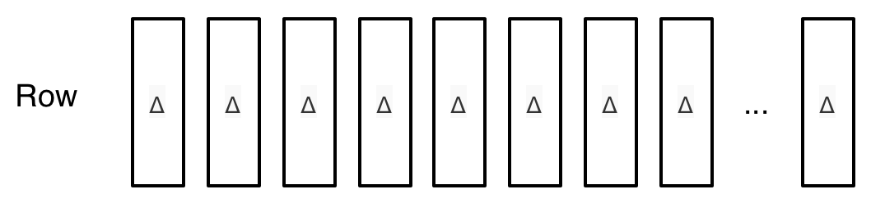
Delta - A Conflict-free Replicated Data Type
Emo Delta is a JSON spec that can represent an incremental update to any JSON document
Emo Deltas is a crucial building block for the entire infrastructure. Not only for SoR, but also for the Databus.
Emo Row is a sequence of such immutable deltas. Writers simply append a delta (even for deletes). Readers resolve them into a single JSON document upon reads.

Slide 21
Delta - A Conflict-free Replicated Data Type
Delta Example:
MIME Type: application/x.json-delta
MIME Type: application/json
Δ1 { "rating": 4, "text": "I like it."}
Δ2 { .., "status": "APPROVED" }
Δ3 { .., "status": if "PENDING" then "REJECTED" end }
{ "rating": 4, "text": "I like it.",
"status": "APPROVED" }

Slide 22
Delta - A Conflict-free Replicated Data Type
Cassandra table structure:
CREATE TABLE sor_deltas (
rowkey blob,
changeid timeuuid,
delta text,
PRIMARY KEY (rowkey, changeid)
) WITH COMPACT STORAGE
AND gc_grace_seconds = 172800 ...
Note: changeid is a Time UUID, and is a clustering key

Slide 23
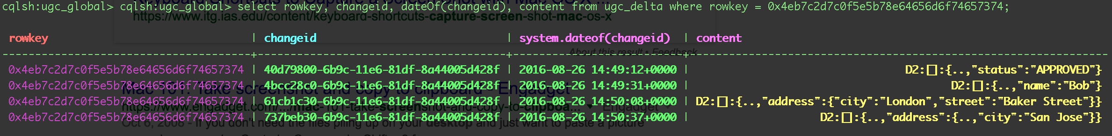
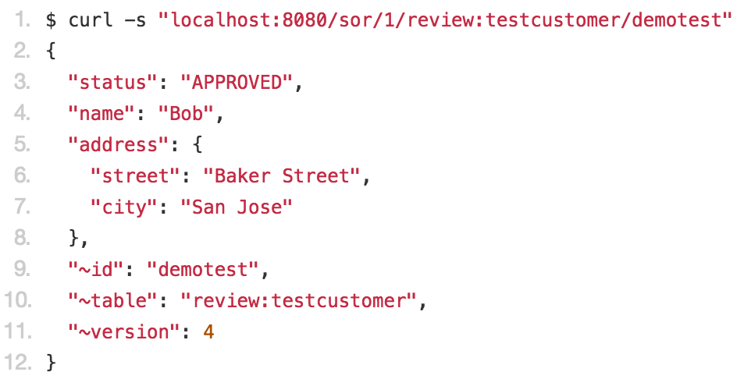
A Conflict-free Replicated Data Type (Delta)
Sample Emo Row in Cassandra
EmoDB resolves the above CQL rows of deltas into a JSON document:

Slide 24
EmoDB – System of Record (SoR)
A simple Key/Value store that holds JSON documents.
Globally distributed (Multi-data-center)
Multi-master writes and reads
Fault tolerant
Horizontal Read/Write Scale
Massive global writes (non-blocking, conflict-free)
Flexible JSON content
Incremental updates without reads (including nested JSON attributes)
Granular Optimistic Concurrency Control (OCC)
Emo Delta

Slide 25
Deltas and Conflict Resolution
US
EU
{“rating”: 5, “text”: “love it”, “status”: “rejected”}
{“rating”: 5, “text”: “love it”, “status”: “rejected”}
{“rating”: 5, “text”: “love it”}
{“rating”: 5, “text”: “love it”}
{“rating”: 5, “text”: “love it”}
App_US
∆3
∆2
App_EU
CASSANDRA
T1:∆1
T1:∆1
Databus
T2:∆1 ∆3
T2:∆1 ∆2
Databus
T3:∆1 ∆2 ∆3
T3:∆1 ∆2 ∆3
∆1 = { “rating”: 5, “text”: “love it” }
∆2 = { ..,“status”: “rejected” }
∆3 = { ..,“status”: if “PENDING” then “APPROVED” end }

Slide 26
EmoDB – System of Record (SoR)
A simple Key/Value store that holds JSON documents.
Globally distributed (Multi-data-center)
Multi-master writes and reads
Fault tolerant
Horizontal Read/Write Scale
Massive global writes (non-blocking, conflict-free)
Flexible JSON content
Incremental updates without reads (including nested JSON attributes)
Granular Optimistic Concurrency Control (OCC)
Emo Delta

Slide 27
Deltas and Granular OCC
Optimistic Concurrency Control (OCC) is usually done by asserting the document version/signature hasn’t changed since our last read
Example:
{"x": 0, "version": 1}
{"x": 0, "y": 1, "version": 2}
{"x": 1, "y": 1, "version": 2} (assertion: version:1) ← This fails as version has changed
Emo does not have row level locking, and only provides OCC

Slide 28
Deltas and Granular OCC
“Conditional” Delta type allows writers to append a delta that is based on any arbitrary existing attribute of the document for OCC.
Example:
P1 reads: {"x": 0, "version": 1}
P2 writes: {"x": 0, "y": 1, "version": 2}
P1 writes: {"x": {..,if 0 then 1}} ← This delta passes even when another irrelevant attribute is updated
Hence, “granular” OCC
The document may have changed for other attributes, but as long as the attribute we care about remains the same
By the way, EmoDB also provides “~version” and “~signature” hash too if that’s your jam.

Slide 29
EmoDB – System of Record (SoR)
A simple Key/Value store that holds JSON documents.
Globally distributed (Multi-data-center)
Multi-master writes and reads
Fault tolerant
Horizontal Read/Write Scale
Massive global writes (non-blocking, conflict-free)
Flexible JSON content
Incremental updates without reads (including nested JSON attributes)
Granular Optimistic Concurrency Control (OCC)
Emo Delta

Slide 30
Reads - Distributed Compaction of Deltas
Over time, deltas will accrue and reads would take longer to resolve
EmoDB needs to compact these deltas by resolving and replacing them with a single resolved delta
In a distributed environment, this can lead to data loss if an out-of-order delta is in flight.
In-flight delta
DC-1

Slide 31
Distributed Compaction Solution
If only we could tell exactly which Cassandra columns in a row (deltas) are fully consistent on all nodes
Let’s call this Full Consistency Timestamp (FCT), such that any column with time UUID before FCT is fully consistent on all nodes.
More formally,
given C, the set of consistent events, and FCT, the full consistency timestamp,
for all events e with timestamp t_{e}, if t_{e} < FCT, e ∈ C
Aka: ∀ e, te | te < FCT => e ∈ C

Slide 32
Distributed Compaction Solution

Slide 33
Distributed Compaction Solution
Exploit Cassandra’s Hinted Handoff feature
Let’s take a look at the Hints table (C* 2.2.4)
cqlsh:system> desc table hints;
CREATE TABLE system.hints (
target_id uuid,
hint_id timeuuid,
message_version int, mutation blob,
PRIMARY KEY (target_id, hint_id, message_version) ) WITH COMPACT STORAGE ..
Note: hint_id is a timeuuid, and also a clustering key

Slide 34
Distributed Compaction Solution - FCT
Determining the oldest hint on a node is trivial. cqlsh:system> SELECT min(hint_id) as oldest_hint from hints;
Oldest hint timestamp tells us that any update before that is fully consistent (edge cases do exist, but resolvable)
So, knowing the oldest hints on all nodes will give us our FCT. If no hints exist, take current time as oldest hint time. Finally:
FCT = min(oldhint_1, oldhint_2,…,old_hint_n) – (2 * rpc_timeout)

Slide 35
Distributed Compaction Solution
Equipped with FCT, we know exactly which deltas any node can compact independently and concurrently without fearing data loss
Basically, any delta with a time UUID less than FCT can be compacted away
Other applications of FCT include monitoring cluster health, global consistency for databus, and synchronizing events cross data center

Slide 36
EmoDB is:
Globally distributed JSON key/value store

Slide 38
EmoDB – Bulk use case
Export all data daily to HDFS/S3 for bulk jobs
No freezing of writes allowed
while providing efficient reads

Slide 39
EmoStash – Global Snapshots
Another application of Emo Deltas – global snapshots without freezing writes !
The snapshot process simply ignores any deltas later than the “snapshot” time to capture and upload the exact view of the globally distributed data store at that moment.
Snapshot cutoff

Slide 40
EmoDB is:
Globally distributed JSON key/value store
, which offers global consistent snapshots

Slide 41
EmoDB – Real time streaming use case

Slide 42
EmoDB Databus
Producers should only update System of Record, not to individual queues or topics
Infinite playback to bootstrap new data sources
Subscribers should only get events they care about
Complete flexibility in creating subscriptions
Multi-data-center guarantees
Global databus

Slide 43
EmoDB Databus
Databus is a special kind of queue. No one explicitly puts events on it.
Databus is tied to System of Record and *all* updates automatically generate an event
one “system” queue which fans out to the subscriptions
Fanout process also “authorizes” events based on subscription owners
Subscribers can simply create a “subscription” with a filter on what tables and/or tags they want to follow.
Emo then starts “DVRing” updates for that subscription
Subscription + Scan = Bootstrap a new datastore
Producers are completely decoupled from subscribers.

Slide 44
Databus - Subscriptions
// To create a subscription to *all* tables
$ curl -s -XPUT -H "Content-Type: application/x.json-condition” \
http://localhost:8080/bus/1/demo-app --data-binary 'alwaysTrue()'
// To create a subscription to only review and catalog tables
--data-binary 'intrinsic("~table:"review:client", "catalog:client")'
// To create a subscription to all tables of a “review” type
--data-binary '{..,"type":"review"}'
// To create a subscription to follow a “moderate” tag regardless of the table
--data-binary '{.., "~tags":contains("moderate")}'

Slide 45
EmoDB Databus
Producers should only update System of Record, not to individual queues or topics ✓
Infinite playback to bootstrap new data sources ✓
Subscribers should only get events they care about ✓
Complete flexibility in creating subscriptions
Multi-data-center guarantees
Global databus

Slide 46
Databus – Multi-Data Center Guarantees
US
EU
Consumer
Producer
Subscribed to tag “HANDLE_THIS”
Updates SoR with tag “HANDLE_THIS”
Databus
Emo (Cassandra)
Databus
Databus only notifies US consumer when the update is replicated to US

Slide 47
Databus – Multi-Data Center Guarantees
Emo does not put the entire document on the data bus. Only the key and “changeId” of the update delta goes on the bus.
EmoDB checks the following before handing out the event :
Either: the document as it appears in the local DC contains the changeID of the update
Or: the changeID is older than FCT (Full Consistency Timestamp)
Applications can achieve global consistency without requiring a GLOBAL level write!
EmoDB Databus replicates globally
And notifies you only when the changes are available with “local_quorum” consistency

Slide 48
EmoDB is:
Globally distributed JSON key/value store
, which offers global consistent snapshots
with a built-in streaming data platform.

Slide 49
But wait … there’s more !
Queue Service
Features “Dedup” queue service
Blob Store – To store big files (photos, pdf, html files, etc.)
API Key Management system – out of the box
All based on Cassandra – Use your existing operational Cassandra skills and tools to maintain an Emo cluster

Slide 50
EmoDB is open source!
https://bazaarvoice.github.io/emodb
https://github.com/bazaarvoice/emodb
EmoDB provides “out of the box” data infrastructure for a globally distributed service oriented architecture
It abstracts out many implementation details, and makes it easy for services to share data seamlessly, all the while making sure a consistent and comprehensive System of Record is available.

Slide 51
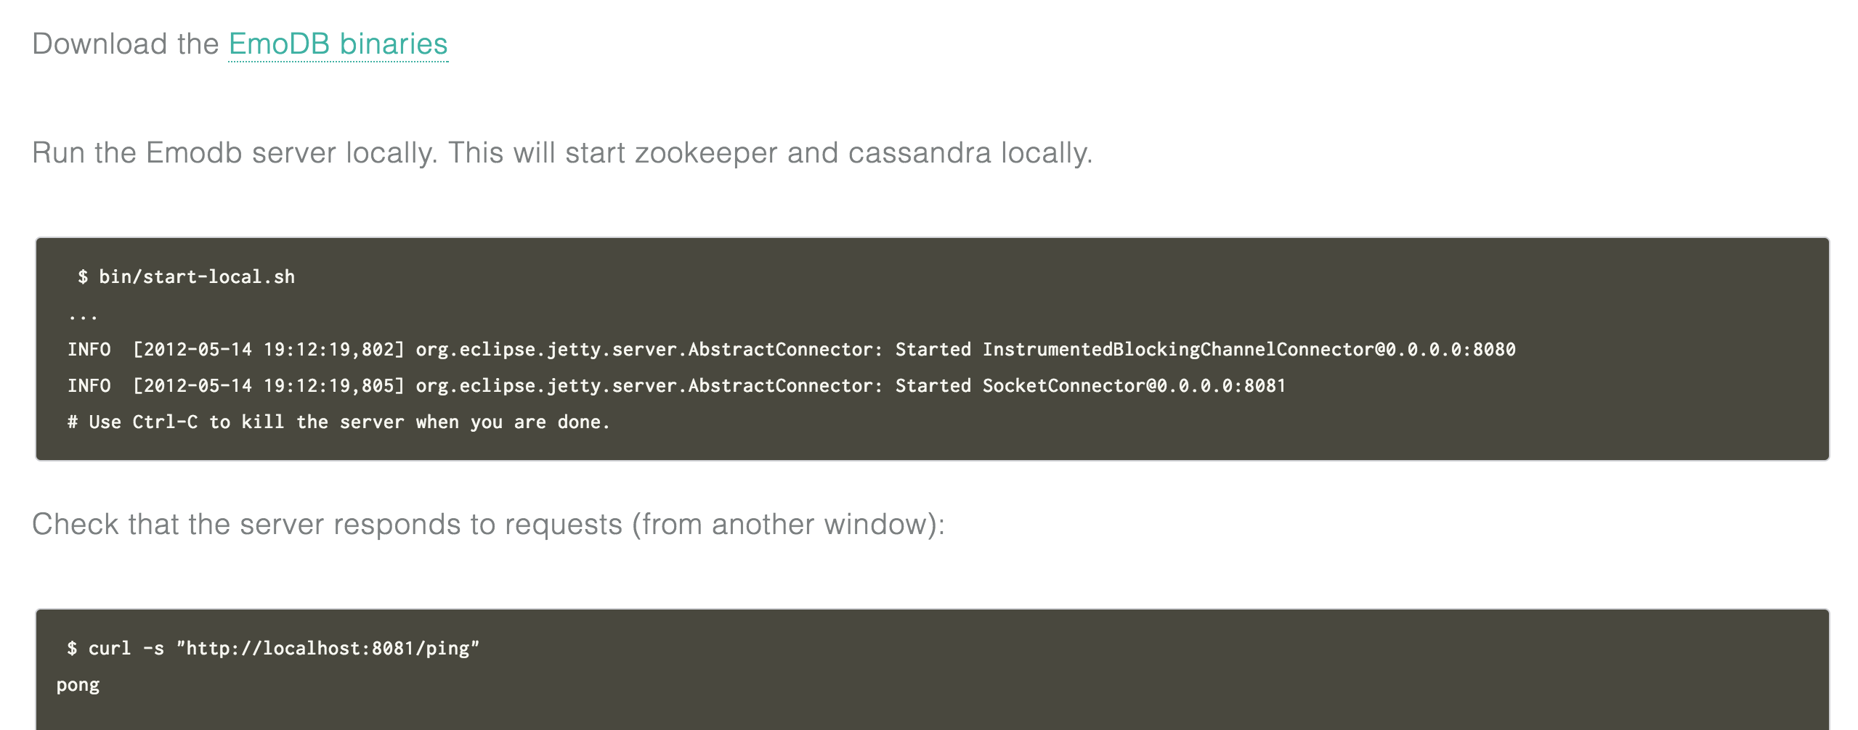
EmoDB is open source!

Slide 52
Thank You !

Slide 53



@Bazaarvoice
Learn
more
@BazaarvoiceDev
http://www.bazaarvoice.com/
http://blog.developer.bazaarvoice.com/

